Slide 1
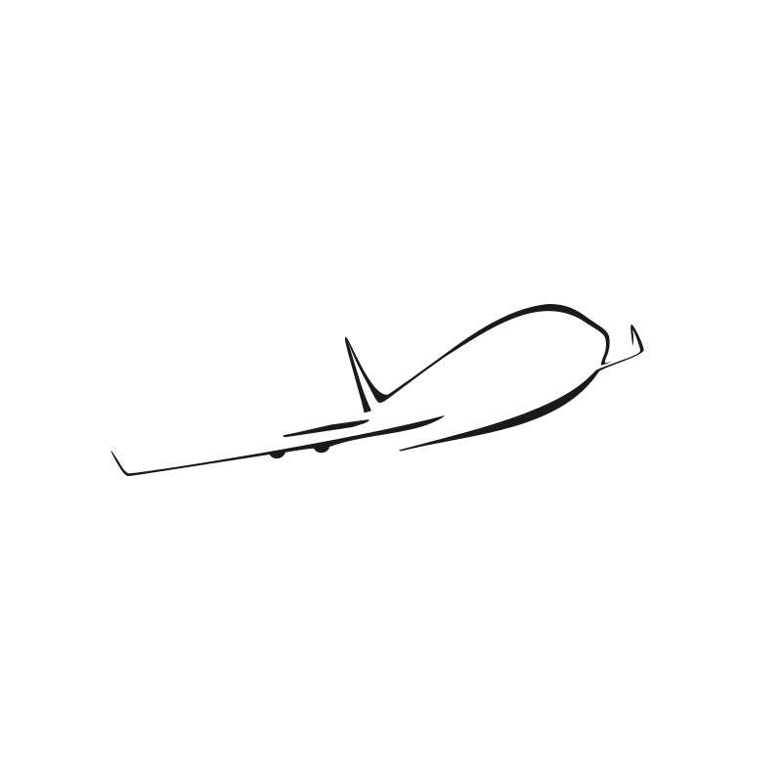
CSC380 – Airplane Application
Andrew Spano, Jimmy Nguyen, Zachary Gudlin

Slide 2
In addition, prepare a presentation that you'll use during the final exam slot of the class. Make a few slides that introduce the team and the project, describe your code base and relevant parts of the document. You will have about 12 minutes per group: spend about 5 minutes presenting your slides, then about 5 minutes more doing a demonstration of your project in front of the class. Make sure you are ready to answer questions in the remaining minutes.

Slide 3
Team Members Andrew Spano Jimmy Nguyen Zachary Gudlin
Contributions:

Slide 4
Modular Code Base [ Launcher, MenuBar, GuiApplication]
GuiApplication is an interface for creating windows.
MenuBar is a standalone addition to our main stage. It only appears after login and can be added/remove easily.
BorderPane.setCenter() was used to dynamically change content on our existing main stage.
Implementing modular code base that can be easily added/removed without affecting other functionality.

Slide 5
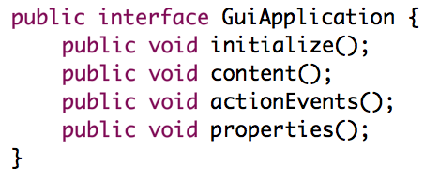
GUI Application
GuiApplication is an interface that requires you implementation to create new a window view.
Ensures that every window is organized and has all its dependencies.
Every window was set with BorderPane.setCenter(); so our stage was dynamically changing content.

Slide 6
Static Methodology [ APZState, AdminState, FilePath]
APZState would save our user information.
AdminState saved software configured files.
File Path would save paths to files via String.
Implementing static methods and variables that can be accessed multiple times in a singleton manner.

Slide 7
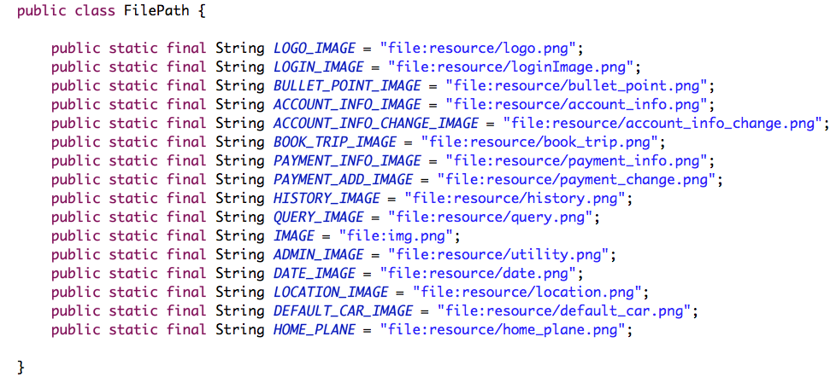
FilePath for example was used to set the path for images. Instead of navigating through code and changing the path if need be, we had a file path class where we stored all the paths.
Ex. new Image(FilePath.LOGO_IMAGE);
This static classes with public static variables can be called via ClassName.Variable

Slide 8
Document relevant parts

